Slide 1

Attacks on TLS
Douglas Stebila
Last updated June 6, 2019

Slide 2
Components of TLS
Crypto primitives
RSA, DSA, ECDSA
Diffie–Hellman, ECDH
DES, 3DES, RC4, AES
Ciphersuite details
Data structures
Key derivation
Advanced functionality
Renegotiation
Libraries
OpenSSL
HMAC
MD5, SHA1, SHA-2
Encryption modes, IVs
Padding
Session resumption
Alerts & errors
Certification / revocation
Applications
Web browsers: Chrome, Firefox, IE/Edge, Safari
Web servers: Apache, IIS, nginx, node, …
GnuTLS
SChannel
Application SDKs
Java JSSE
Negotiation
Certificates
Key reuse
Compression
LibreSSL, BoringSSL
Export grade
State machine
Protocols
HTTP, IMAP, ..
NSS
Everest / miTLS
s2n

Slide 3
Provable security analysis of TLS
Crypto primitives
RSA, DSA, ECDSA
Diffie–Hellman, ECDH
DES, 3DES, RC4, AES
Ciphersuite details
Data structures
Key derivation
Advanced functionality
Renegotiation
Libraries
OpenSSL
HMAC
MD5, SHA1, SHA-2
Encryption modes, IVs
Padding
Session resumption
Alerts & errors
Certification / revocation
Applications
Web browsers: Chrome, Firefox, IE/Edge, Safari
Web servers: Apache, IIS, nginx, node, …
GnuTLS
SChannel
Application SDKs
Java JSSE
Negotiation
Certificates
Key reuse
Compression
LibreSSL, BoringSSL
Everest / miTLS
Export grade
State machine
Protocols
HTTP, IMAP, ..
NSS
s2n
Provable security
Record layer: sLHAE
Handshake layer: ACCE

Slide 4
Provable security and formal methods analysis of TLS
Crypto primitives
RSA, DSA, ECDSA
Diffie–Hellman, ECDH
DES, 3DES, RC4, AES
Ciphersuite details
Data structures
Key derivation
Advanced functionality
Renegotiation
Libraries
OpenSSL
HMAC
MD5, SHA1, SHA-2
Encryption modes, IVs
Padding
Session resumption
Alerts & errors
Certification / revocation
Applications
Web browsers: Chrome, Firefox, IE/Edge, Safari
Web servers: Apache, IIS, nginx, node, …
NSS
SChannel
Application SDKs
Java JSSE
Negotiation
Certificates
Key reuse
Compression
LibreSSL, BoringSSL
Everest / miTLS
Export grade
State machine
Protocols
HTTP, IMAP, ..
GnuTLS
s2n
Provable security
Record layer: sLHAE
Handshake layer: ACCE
Formal methods

Slide 5
Attacks on TLS
Termination,
Cookie Cutter
SLOTH
POODLE
ZombiePOODLE
GoldenDOODLE
Bleichenbacher
Debian OpenSSL
entropy bug
Crypto primitives
RSA, DSA, ECDSA
Diffie–Hellman, ECDH
DES, 3DES, RC4, AES
Ciphersuite details
Data structures
Key derivation
Advanced functionality
Renegotiation
Libraries
OpenSSL
HMAC
MD5, SHA1, SHA-2
Encryption modes, IVs
Padding
Session resumption
Alerts & errors
Certification / revocation
Applications
Web browsers: Chrome, Firefox, IE/Edge, Safari
Web servers: Apache, IIS, nginx, node, …
NSS
SChannel
Application SDKs
Java JSSE
Negotiation
Certificates
Key reuse
Compression
LibreSSL, BoringSSL
Export grade
State machine
Protocols
HTTP, IMAP, ..
GnuTLS
Everest / miTLS
s2n
Bleichenbacher,
Goldberg & Wagner Netscape PRNG attack
BEAST
SSL 2.0 downgrade,
FREAK, Logjam
Cross-protocol DH/ECDH attack
Heartbleed
Collisions
goto fail;
BERserk
High-STEKs
Lucky13
Selfie
Triple handshake attack
CA breaches
Ray & Dispensa
“Most dangerous code…”
MalloDroid
Frankencerts
Sweet32
Cross-protocol DH/ECDH attack
RC4 biases,
rc4nomore,
Bar Mitzvah
CRIME, BREACH, HEIST
Lucky microseconds
FREAK, Logjam
Jager et al.
DROWN
CCS injection
Virtual host confusion
STARTTLS injection
SMACK
SSL stripping

Slide 6
Attacks on TLS
* denotes theoretical basis for later practical attack

Slide 7
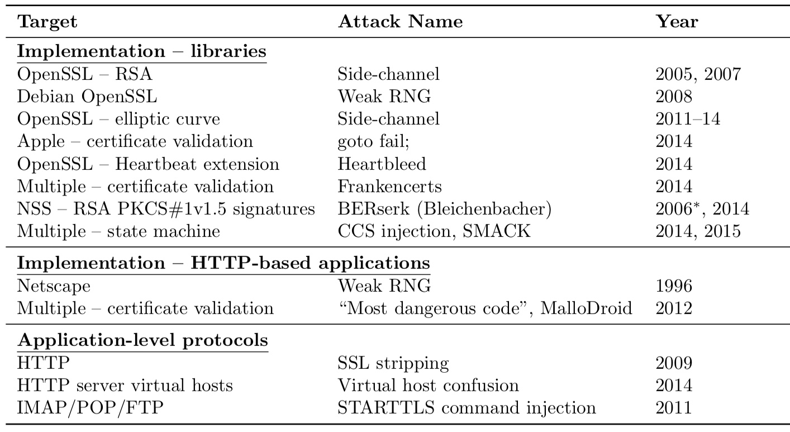
Attacks on TLS
* denotes theoretical basis for later practical attack

